Slide 1

Lesson 10: CN4003
Process, Design, and Marketing
Dr Fadi Safieddine
Dr. Fadi Safieddine Copyright 2021
1

Slide 2
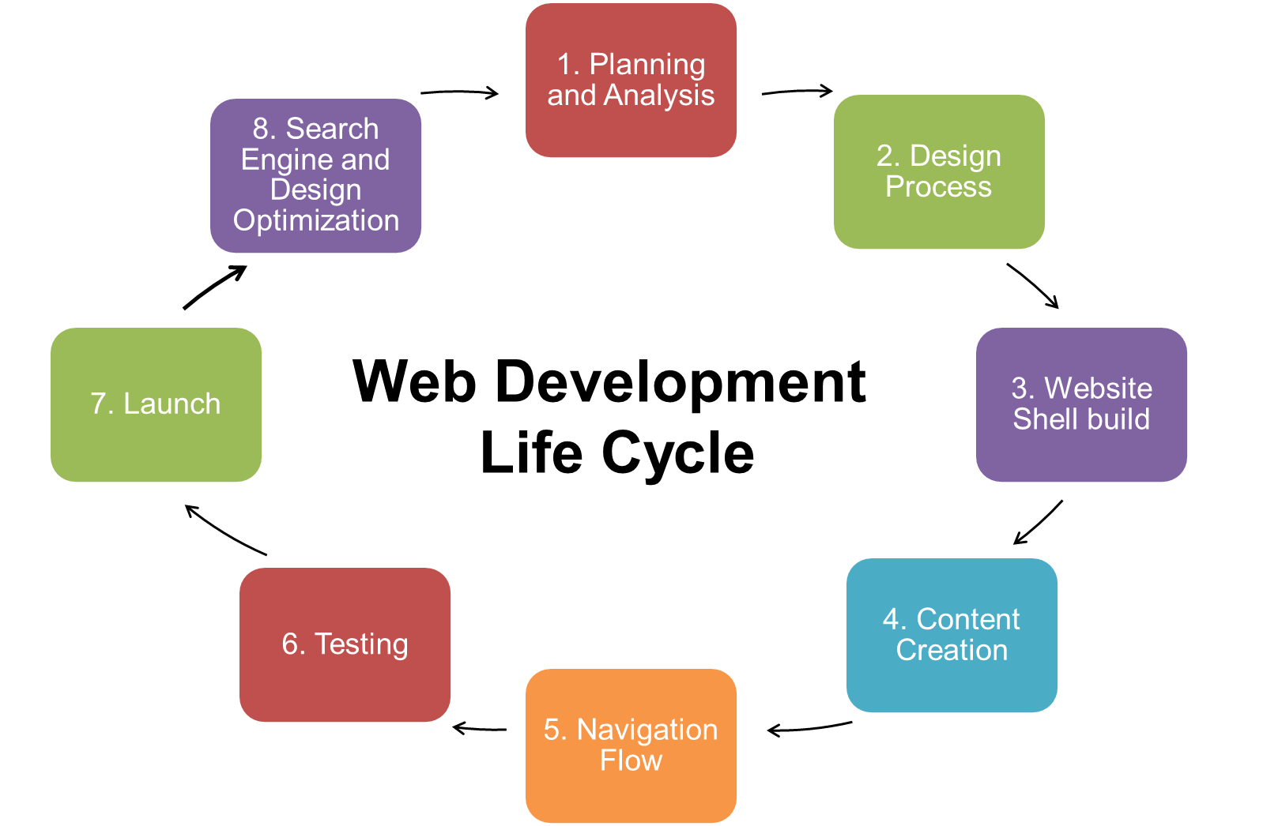
Lecture content:
Web Design Life Cycle
1. Planning and Requirement Analysis
2. Design Process
3. Website Shell build
4. Content Creation
5. Navigation Flow
6. Testing
7. Launch
8. Search Engine and Design Optimization

Slide 3
1. Planning and Analysis
2. Design Process
3. Website Shell build
4. Content Creation
5. Navigation Flow
6. Testing
8. Search Engine and Design Optimization
7. Launch
Web Development
Life Cycle
Notes:
Source: http://www.jamboreeconsult.com/web-development-services/

Slide 4
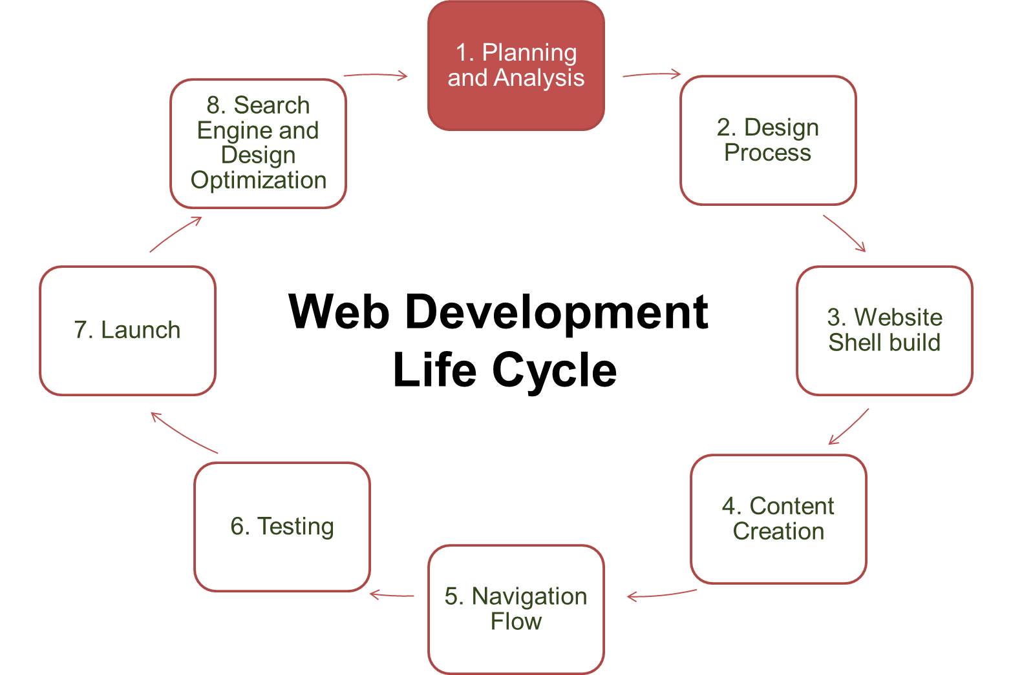

1. Planning and Requirement Analysis
MAY

Slide 5
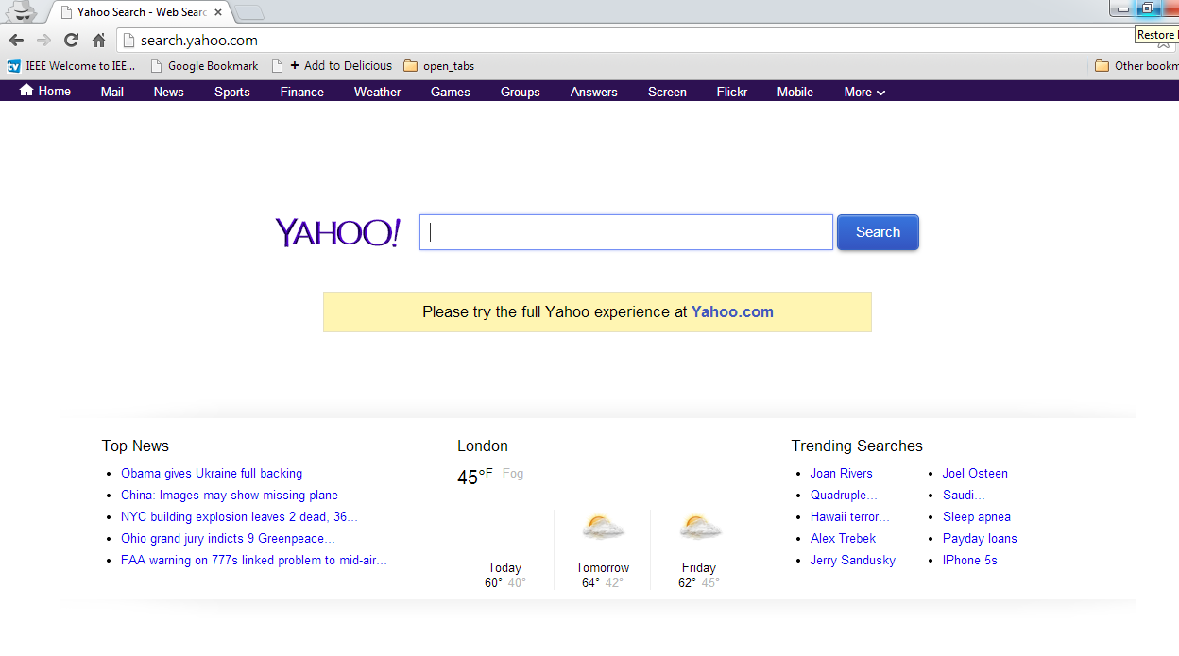
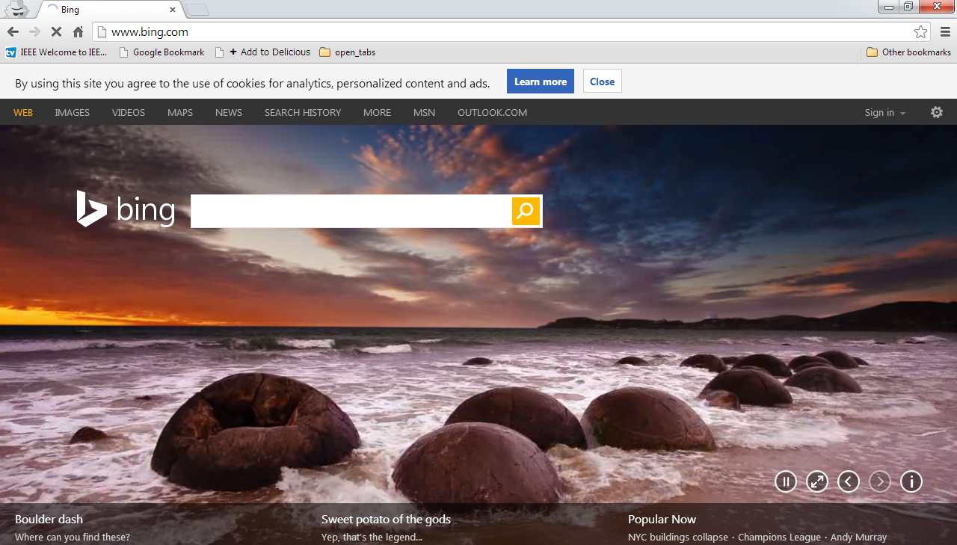
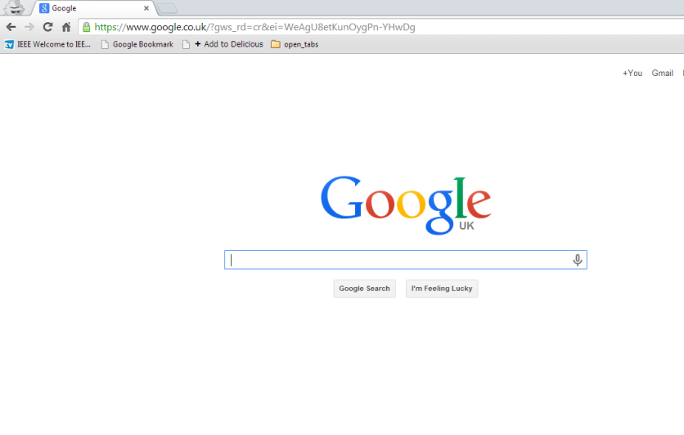
1. Planning and Requirement Analysis

Slide 6
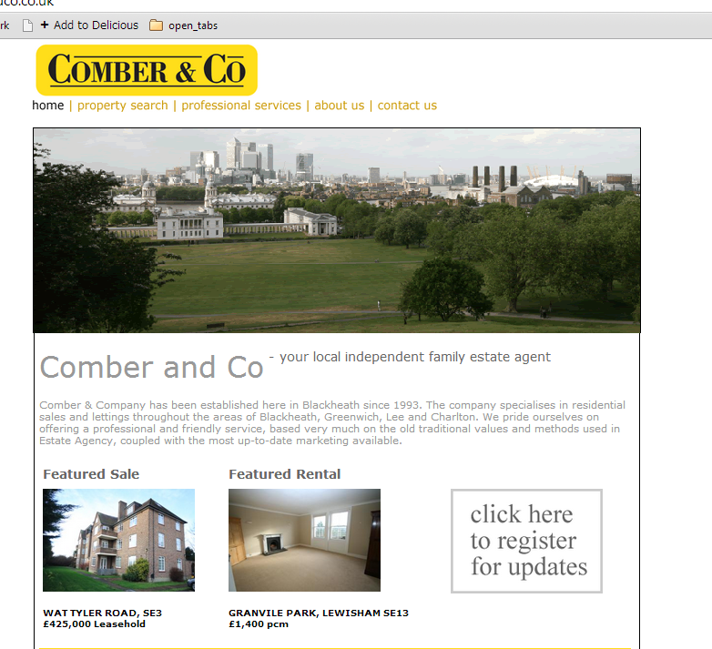
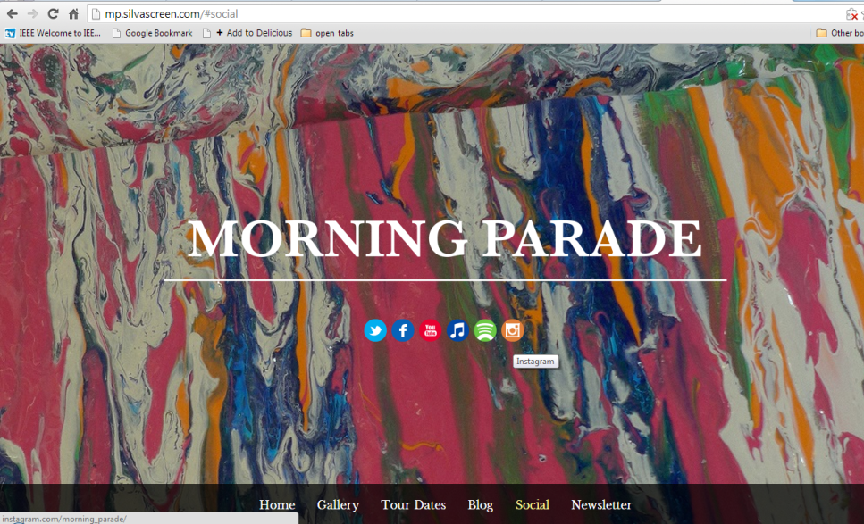
1. Planning and Requirement Analysis

Slide 7
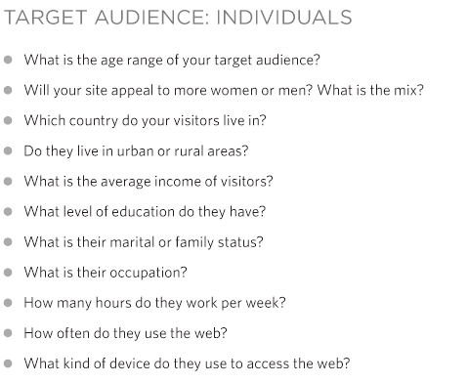
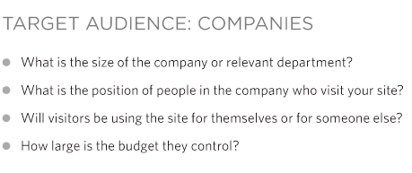
1. Planning and Requirement Analysis

Slide 8
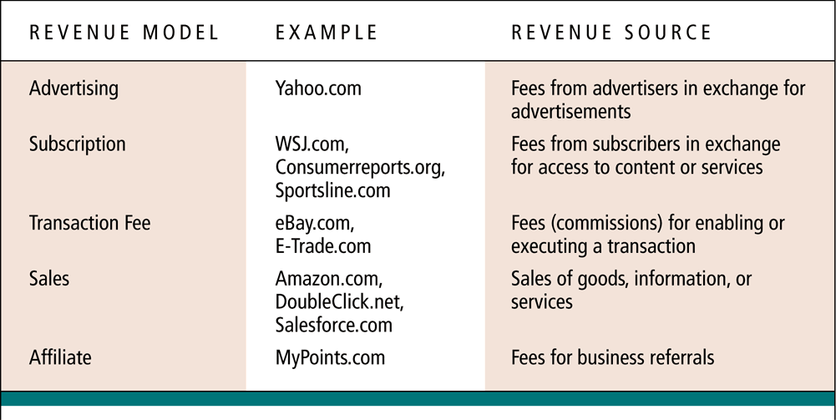
1. Planning and Requirement Analysis
Five primary revenue models

Slide 9
End of Part 1
Activity 10.1. First step in any web or app design is ‘Planning and Requirement Analysis’ which means:
Understanding what the purpose of the website.
Understanding the users of the websites.
Understanding how we will make money from the website.
All of the above.

Slide 10
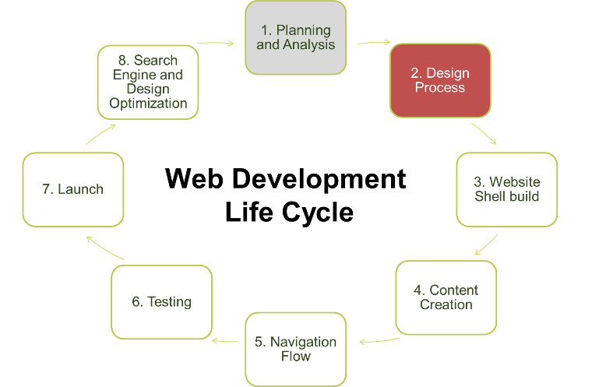
2. Design Process: Wireframe
Part 2

Slide 11
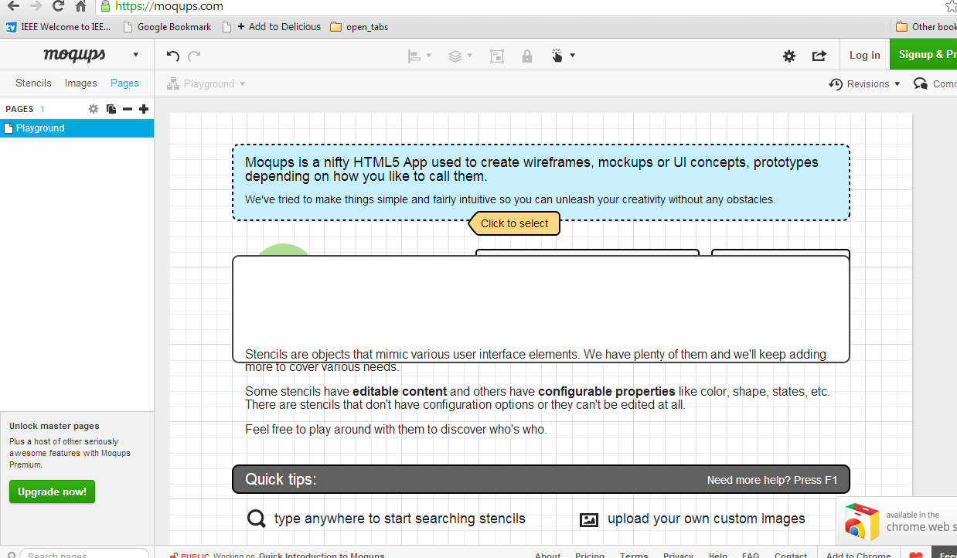
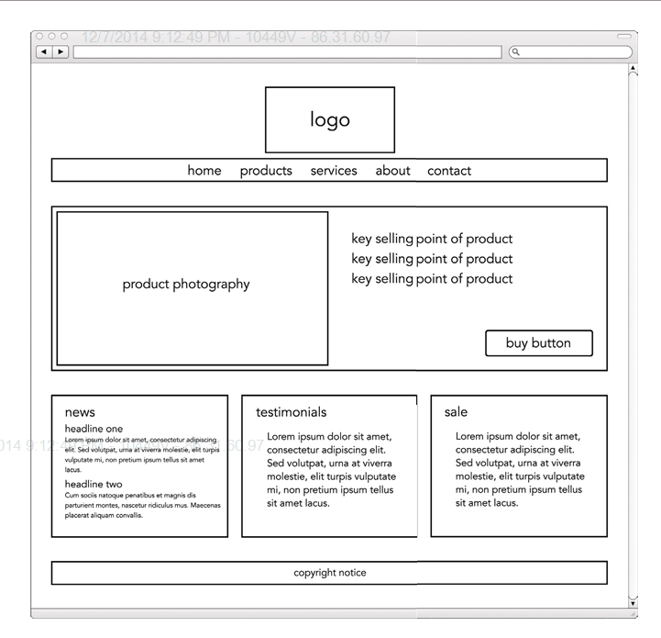
2. Design Process: Wireframe

Slide 12
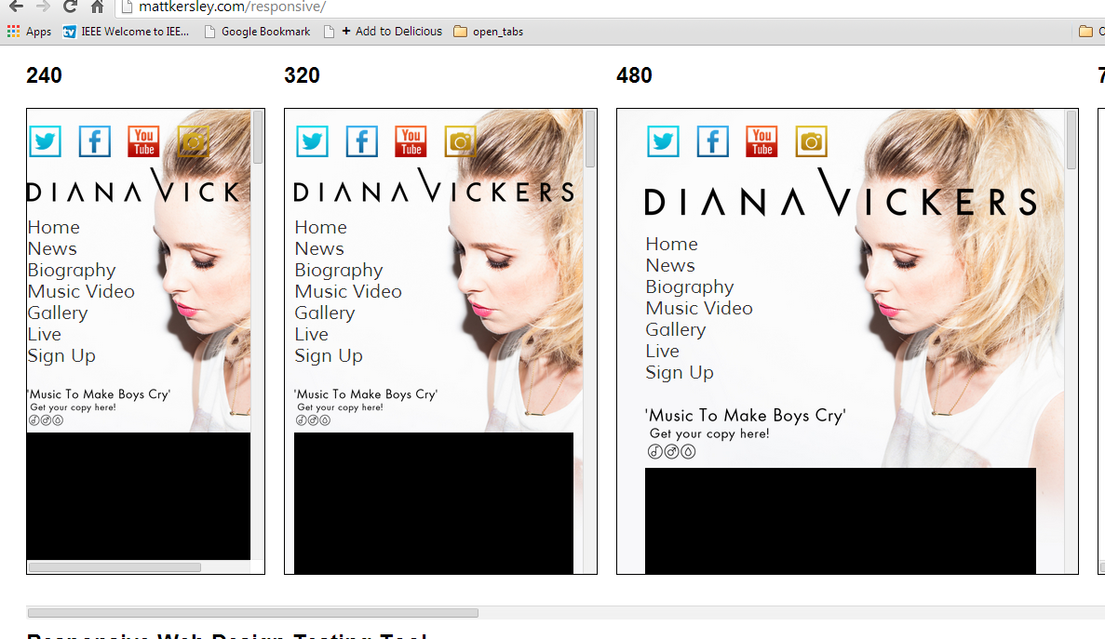
2. Design Process: Responsive Website

Slide 13
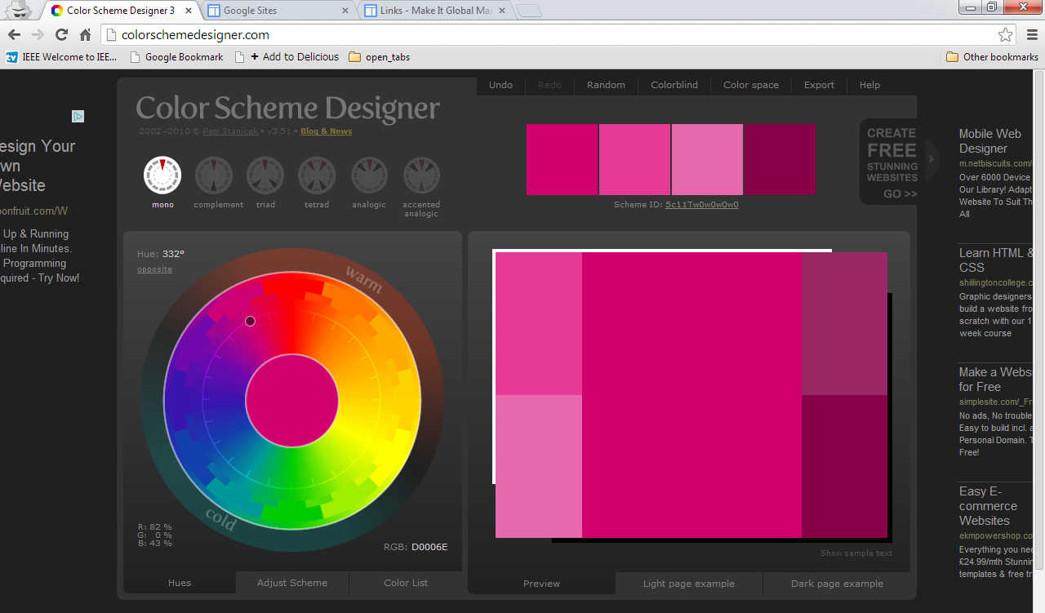
2. Design Process: Colour Scheme

Slide 14
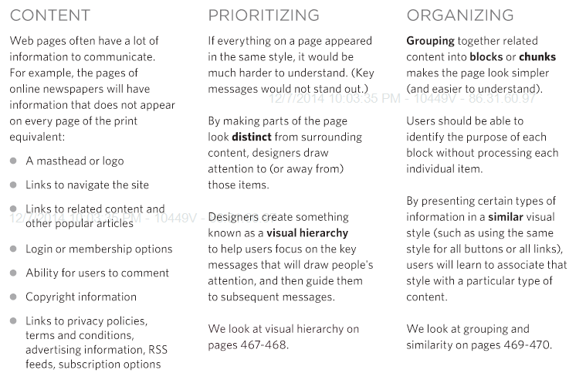
2. Design Process: Your message

Slide 15
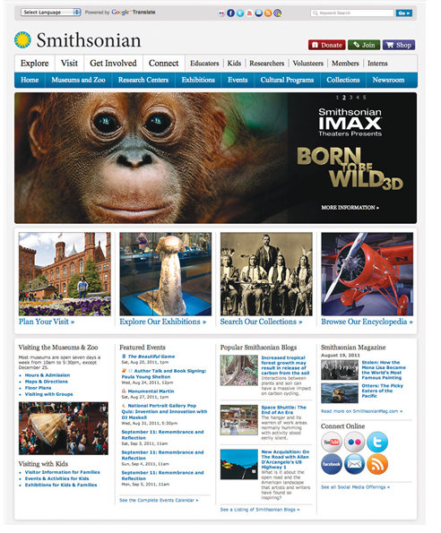
2. Design Process: Visual Hierarchy
refers to the order in which your eyes perceive what they see. It is created by adding visual contrast between the items being displayed. Items with higher contrast are recognized and processed ﬁrst.

Slide 16
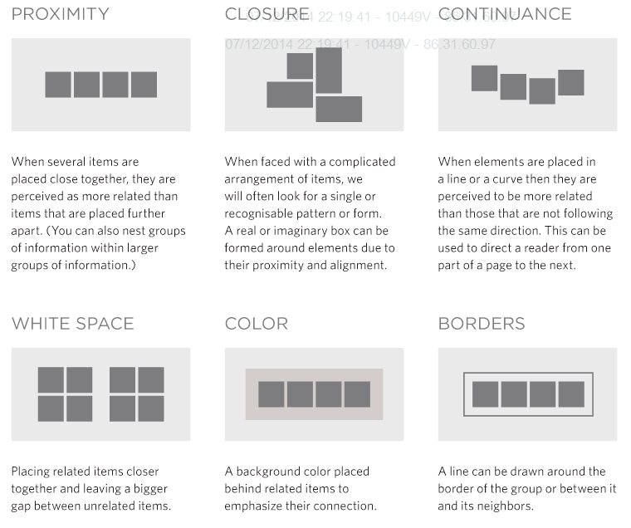
2. Design Process: Groupings

Slide 17
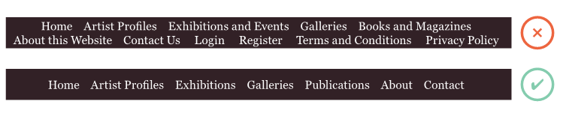
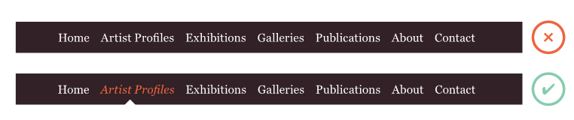
2. Design Process: Site Navigation

Slide 18
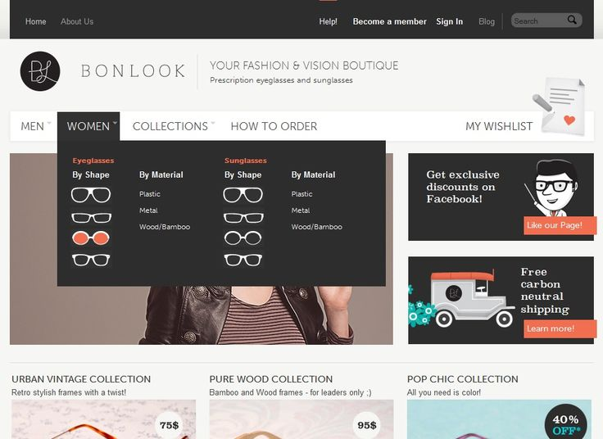
2. Design Process: Site Navigation

Slide 19
End of Part 2
Activity 10.2. Part of the Design Process, organise these steps in the ‘logical’ order:
Wireframe
Image layout and size
Grouping of images
Colour codes
Menus
Navigation design
Agreed design signed

Slide 20
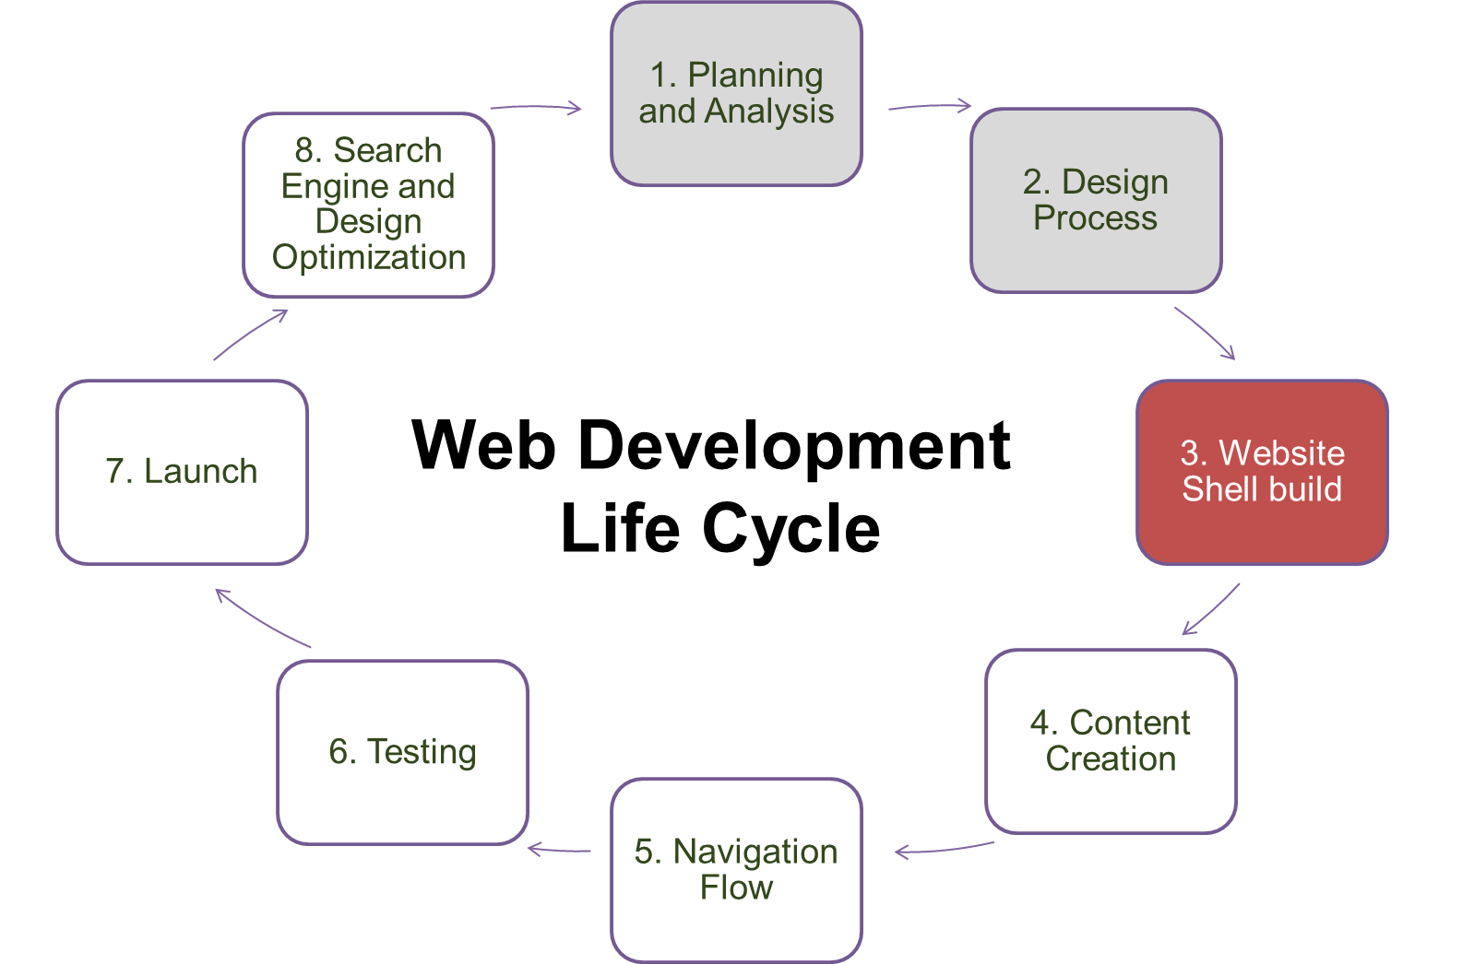
3. Website Shell Building
Part 3

Slide 21
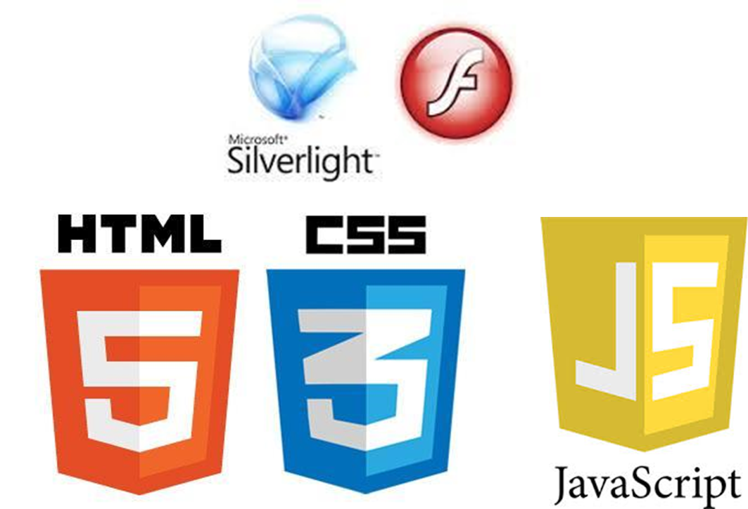
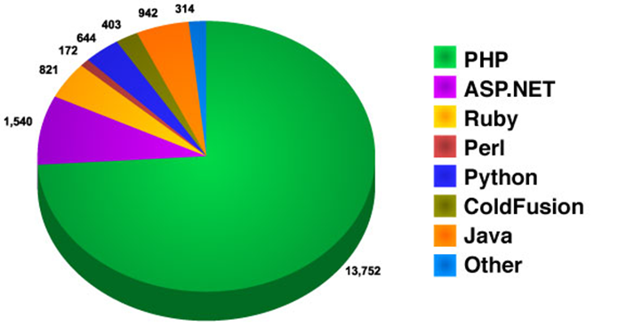
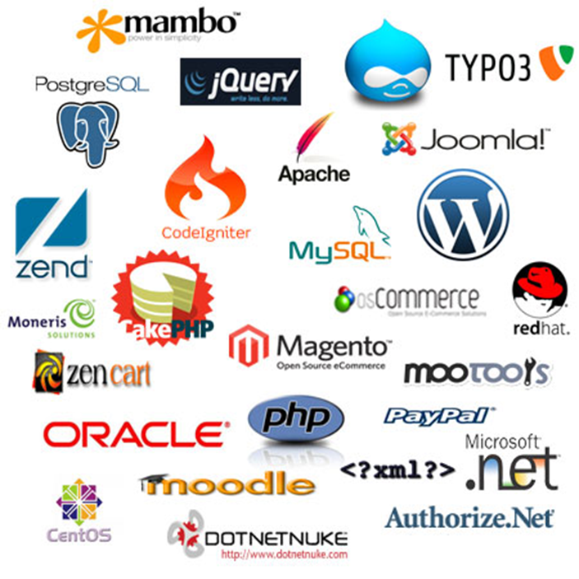
3. Website Shell Building

Slide 22
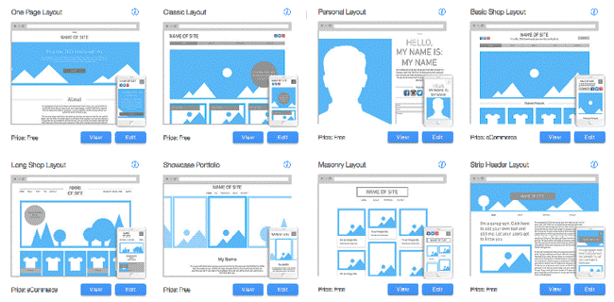
3. Website Shell Building

Slide 23

3. Website Shell Building

Slide 24
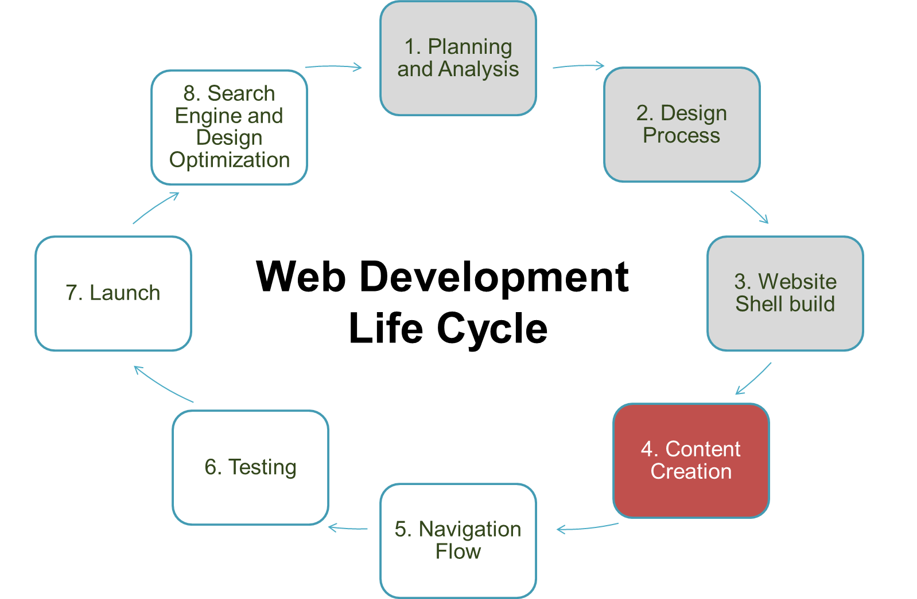
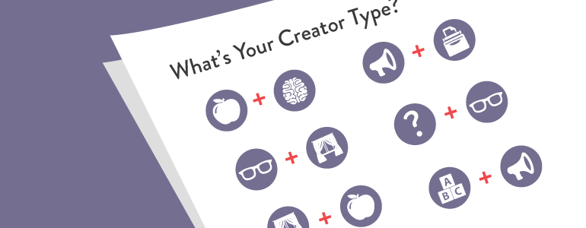
4. Creating Content

Slide 25
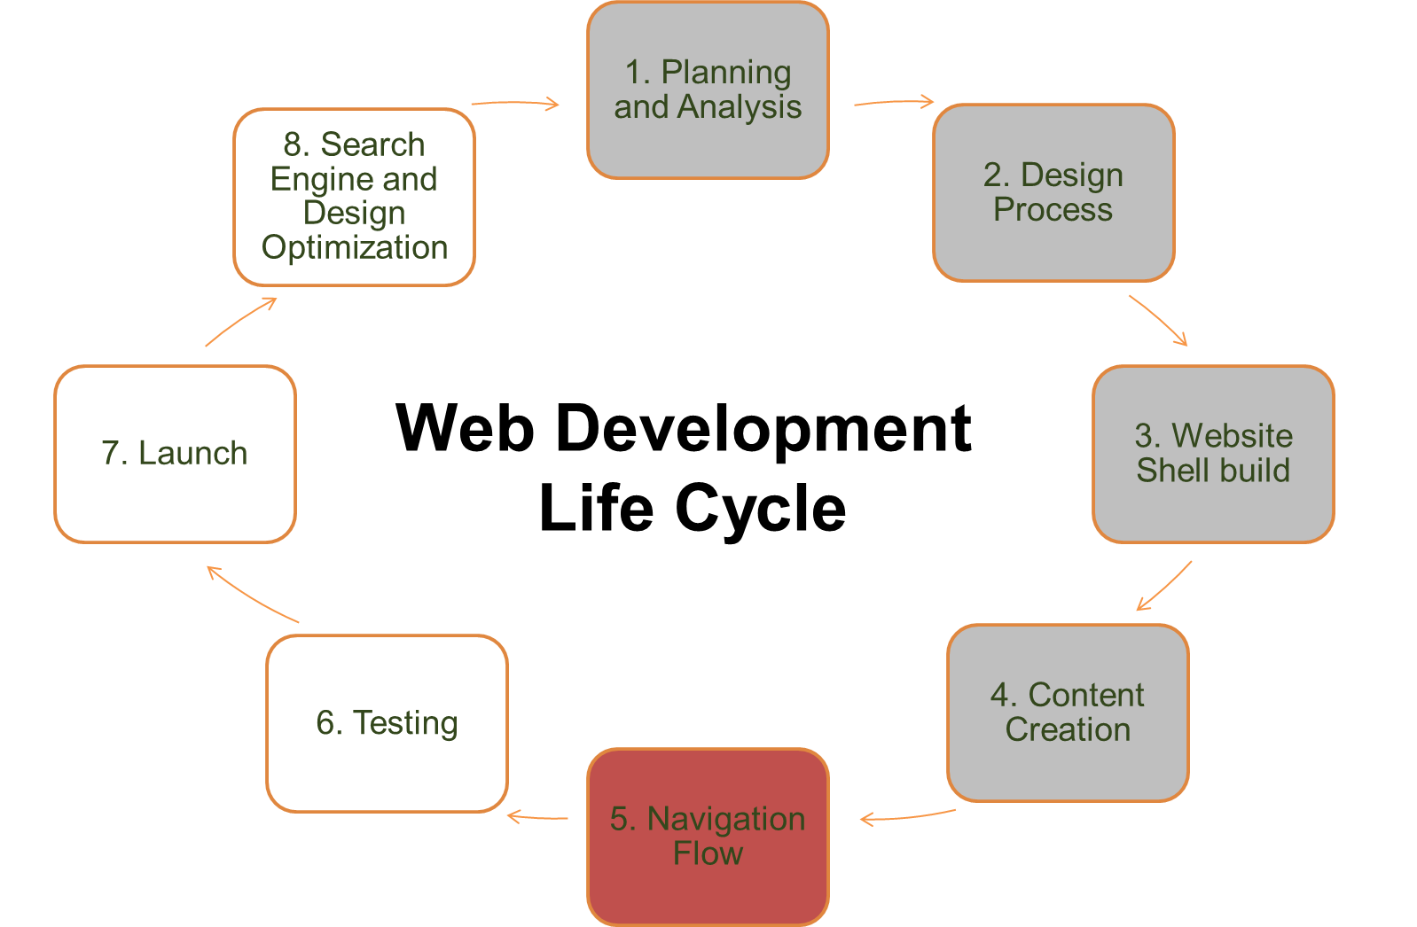
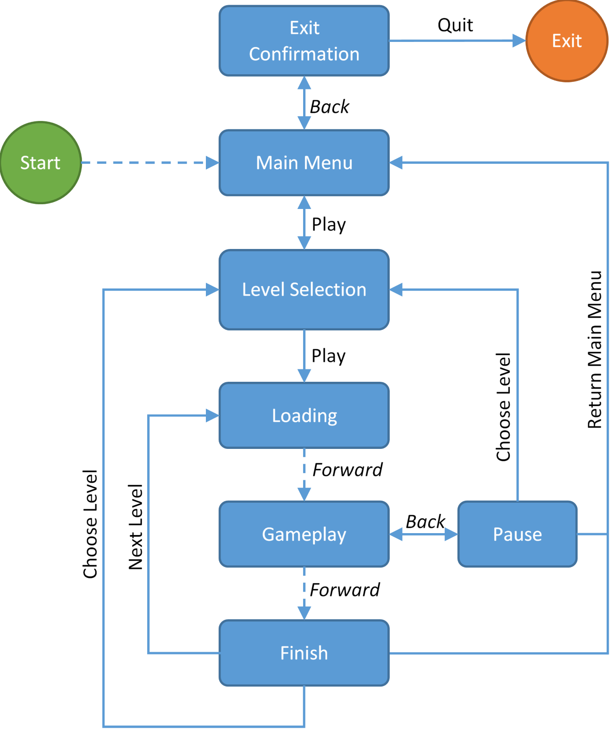
5. Navigation Flow

Slide 26
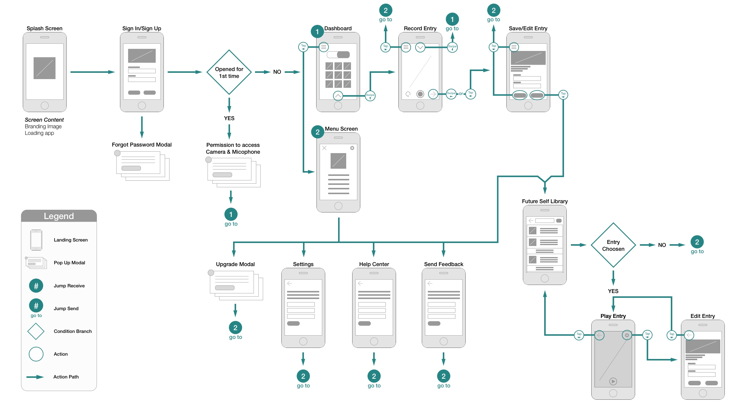
5. Navigation Flow

Slide 27
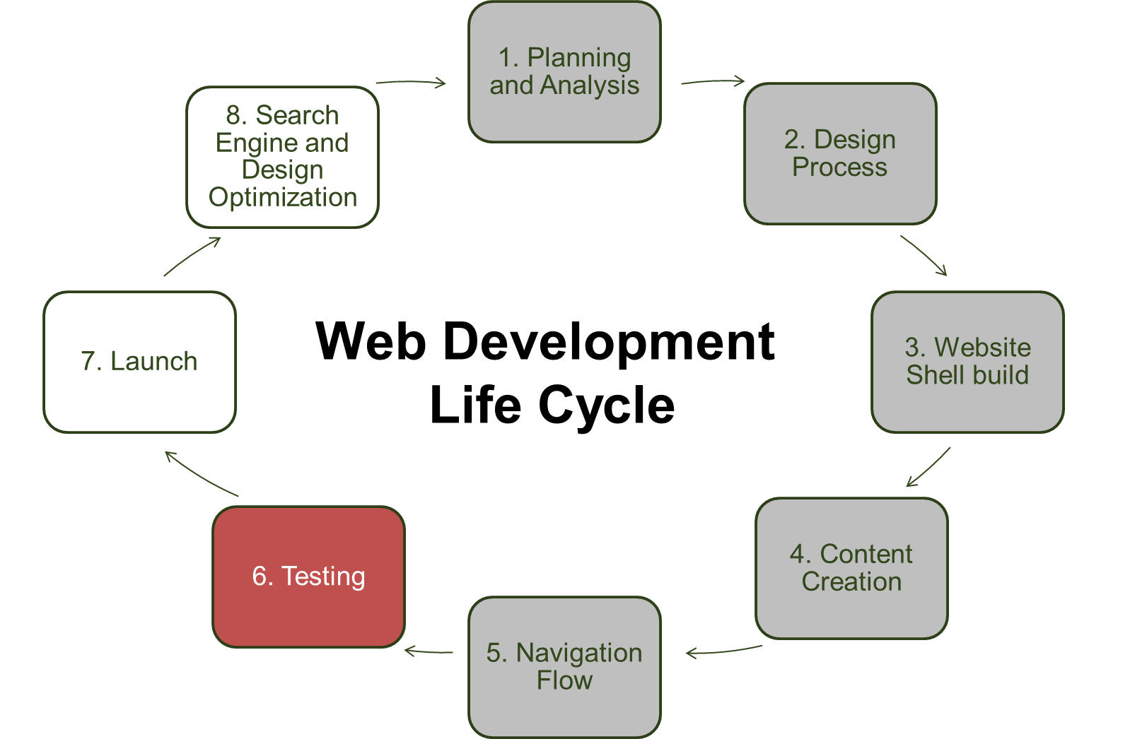
6. Testing
Test log:
Create a log (table)
Test each page, buttons, links, images…etc.
Record comments
Similar to how you researched websites at the start of the term.
Look at Functionality, Design, Accessibility…etc.

Slide 28
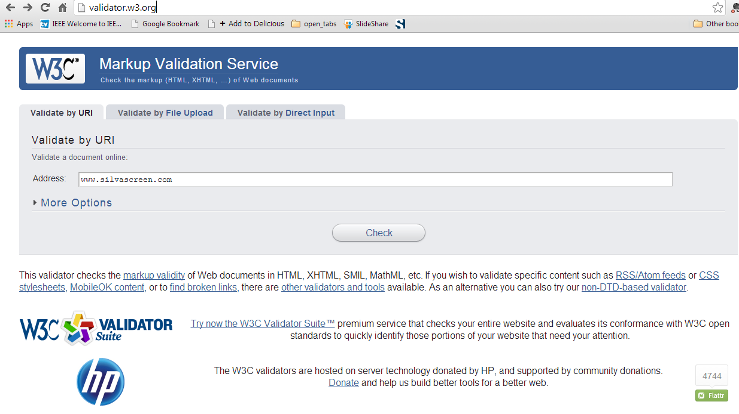
6. Testing

Slide 29
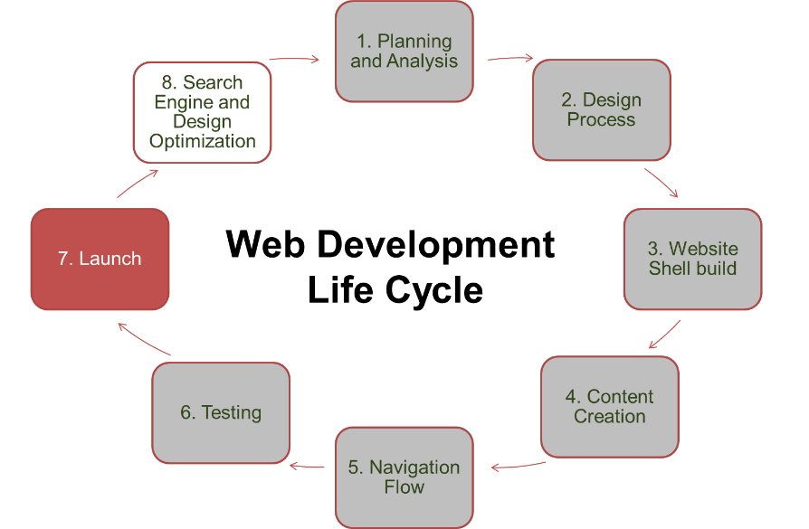
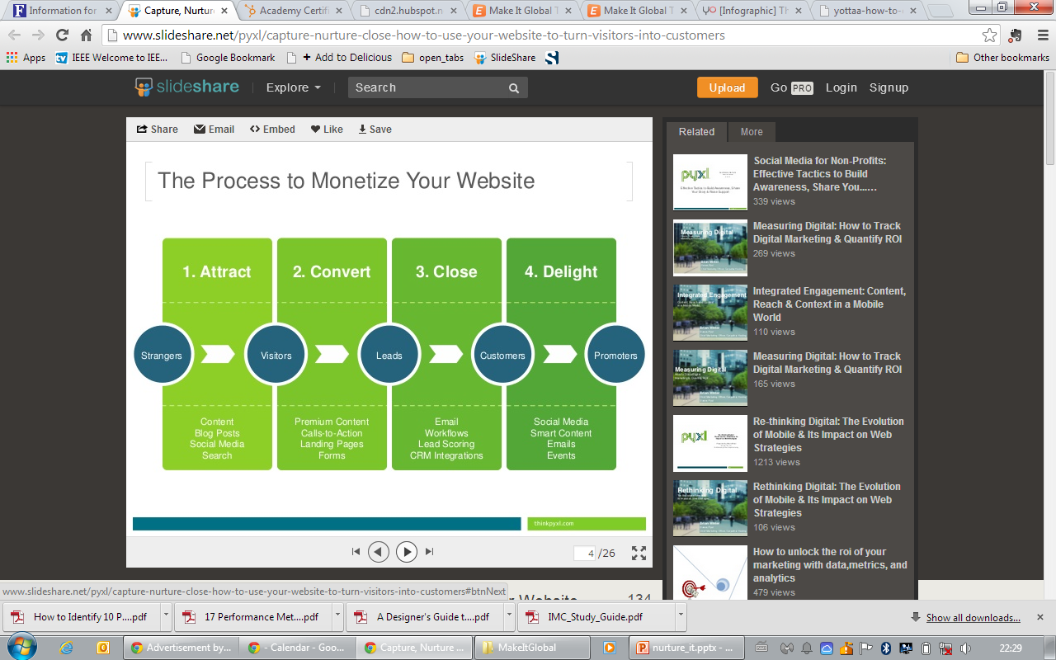
Making money
7. Launch
http://www.slideshare.net/pyxl/capture-nurture-close-how-to-use-your-website-to-turn-visitors-into-customers

Slide 30
Building Traffic
7. Launch
Content
3 C’s Approach
Commerce
Community

Slide 31

Get Social
7. Launch

Slide 32



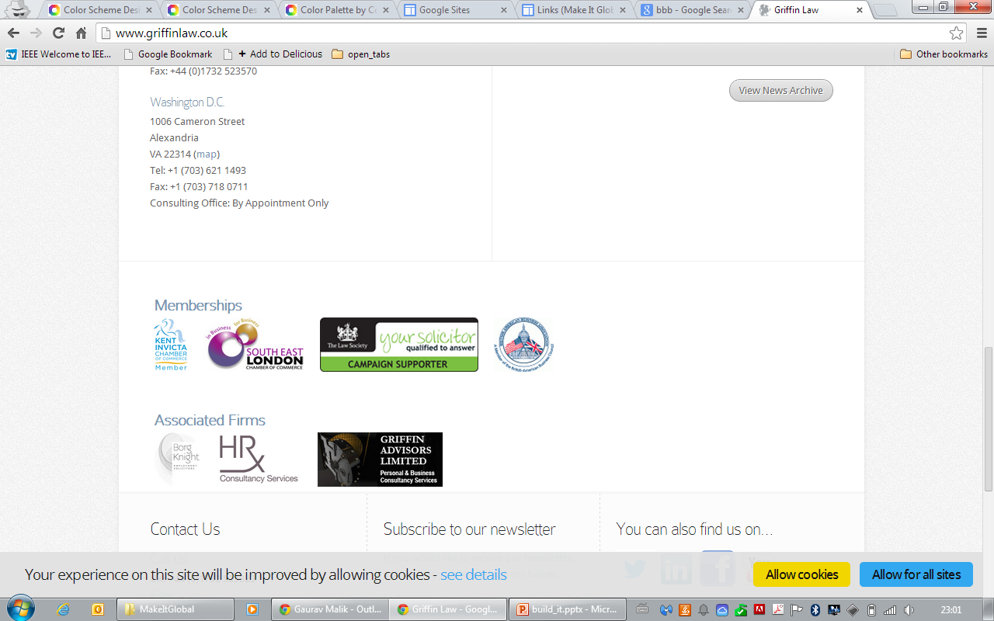
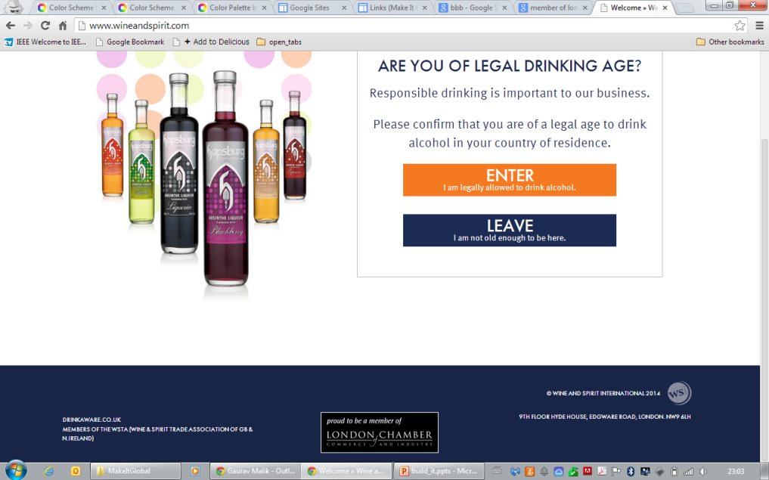

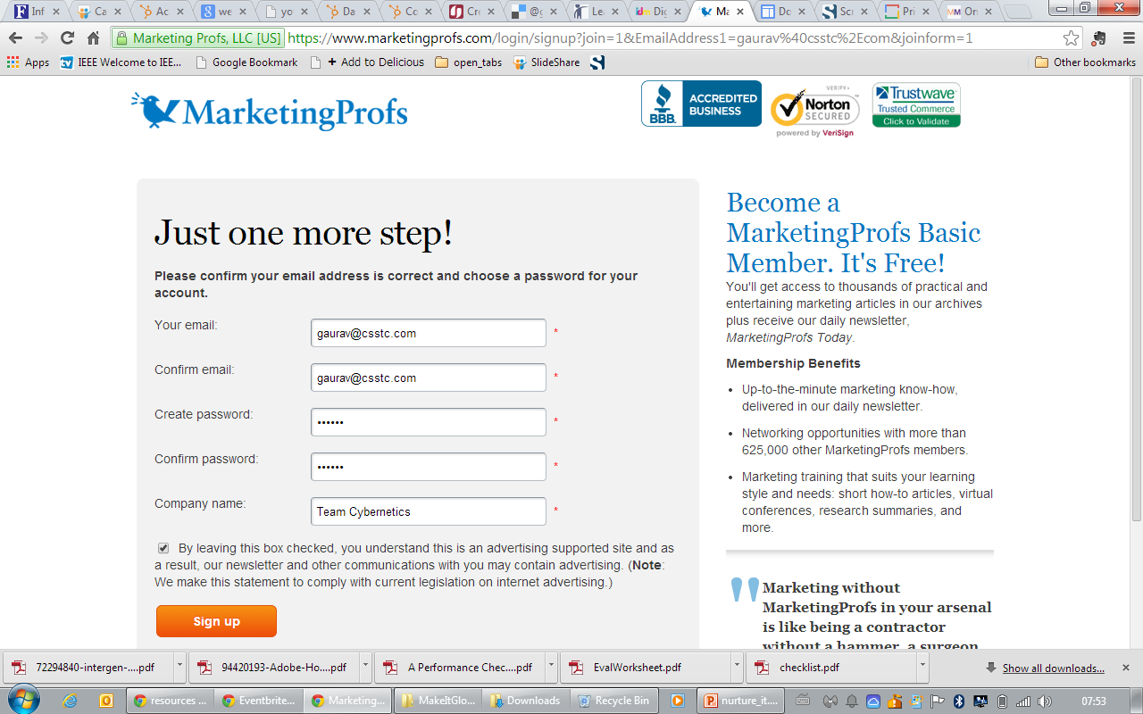
Security stamps of Approval
7. Launch

Slide 33
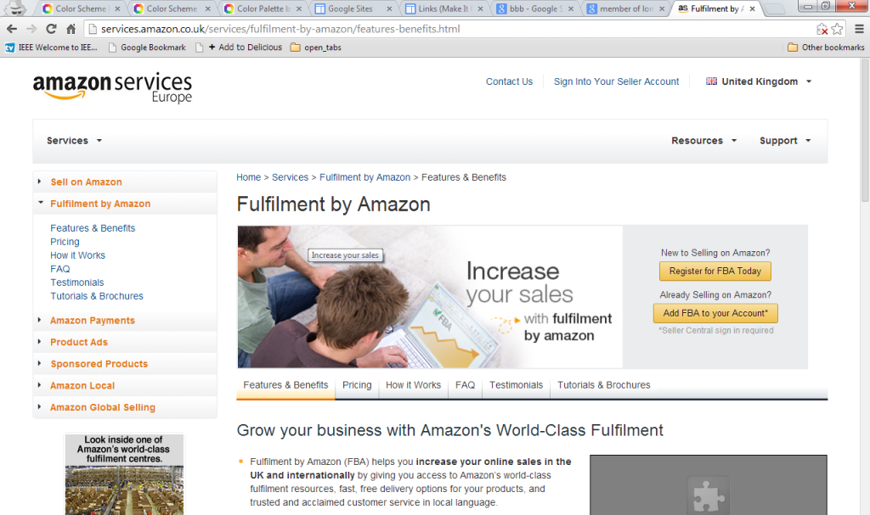
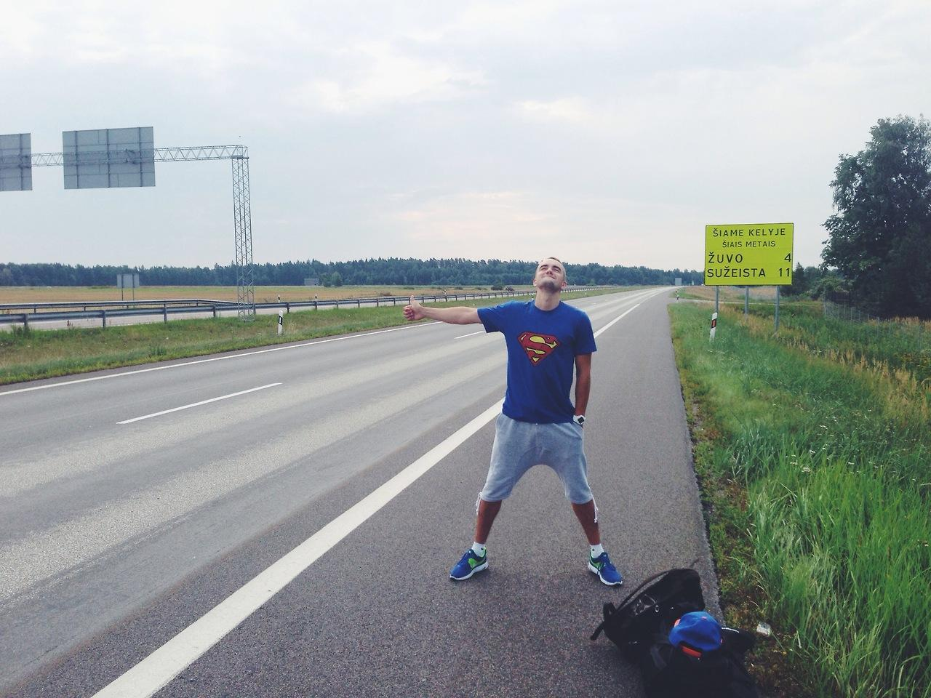
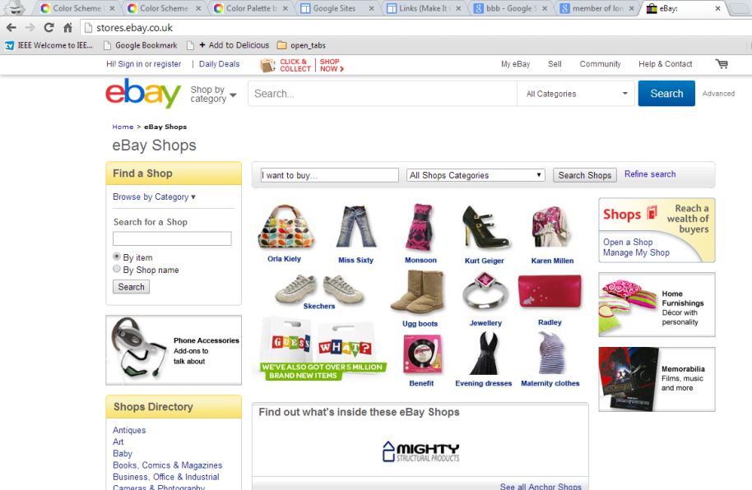
Get Someone Else: (Outsource It)
7. Launch

Slide 34
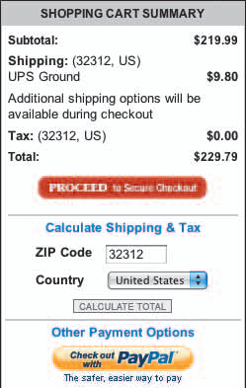
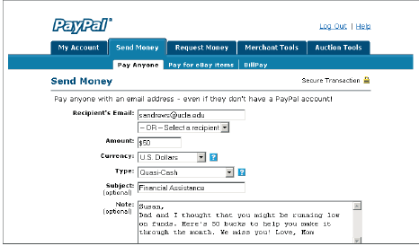
Get Paid
7. Launch
www.paypal.com

Slide 35
End of part 3
Activity 10.3. What is the name of the website we recommended to test the codes of your page:
W3Schools.com
Validator.W3.org
Authenticate.info
Notepad++.com
All of the above

Slide 36
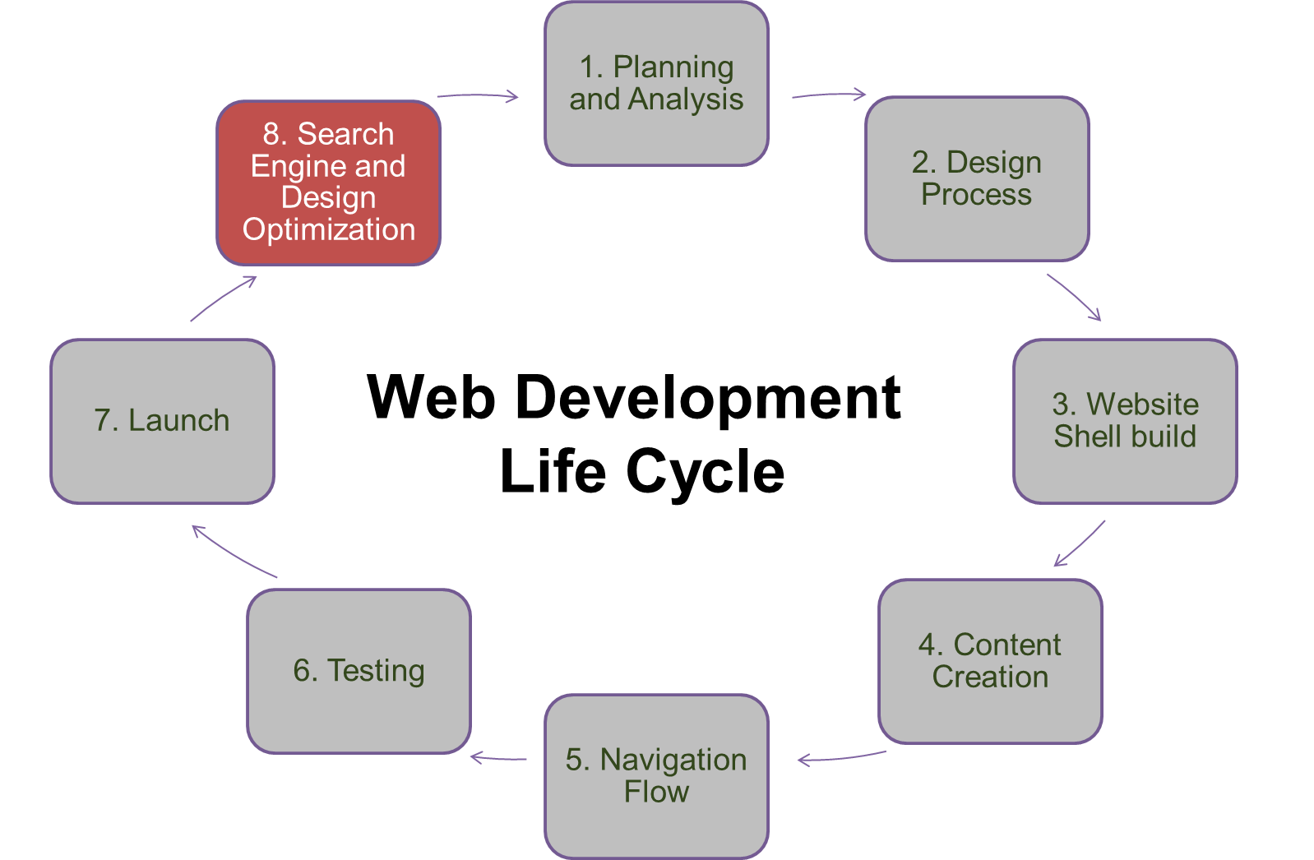
8. SEO and Design Optimization
Part 4

Slide 37
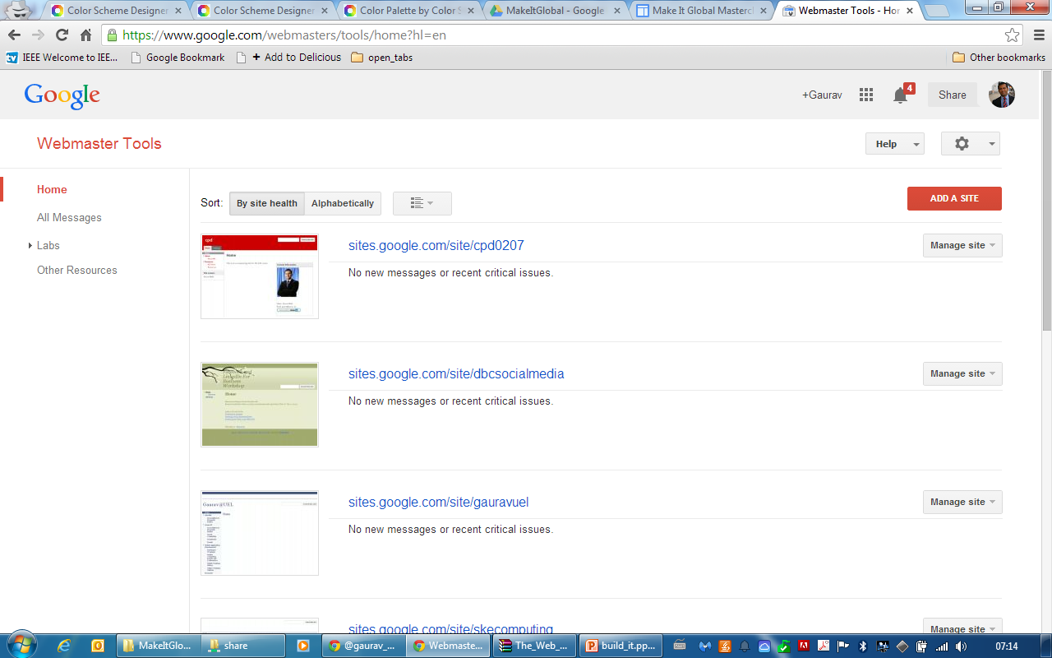
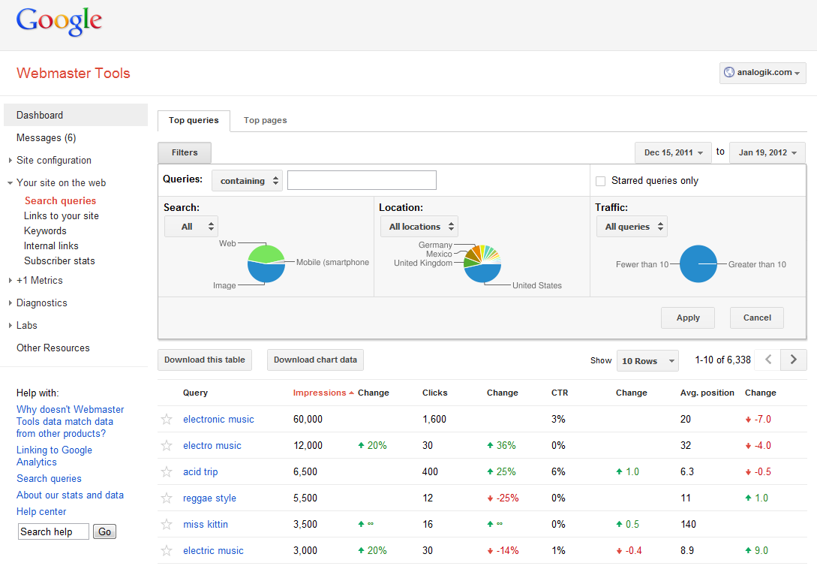
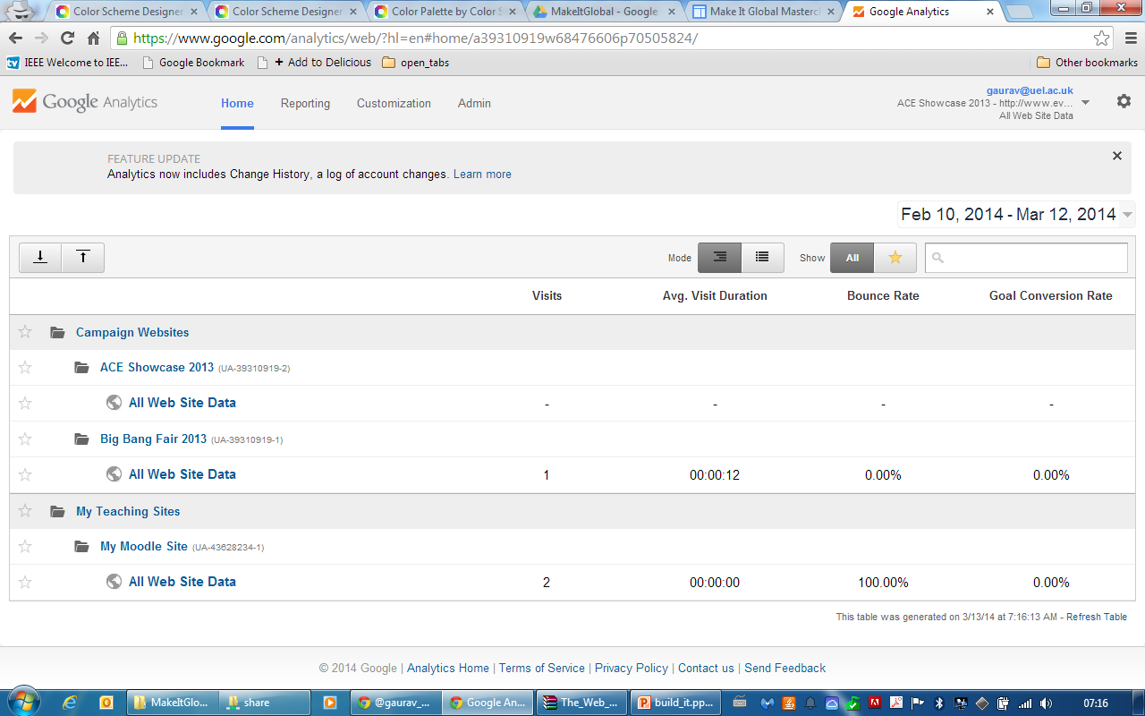
8. SEO and Design Optimization

Slide 38
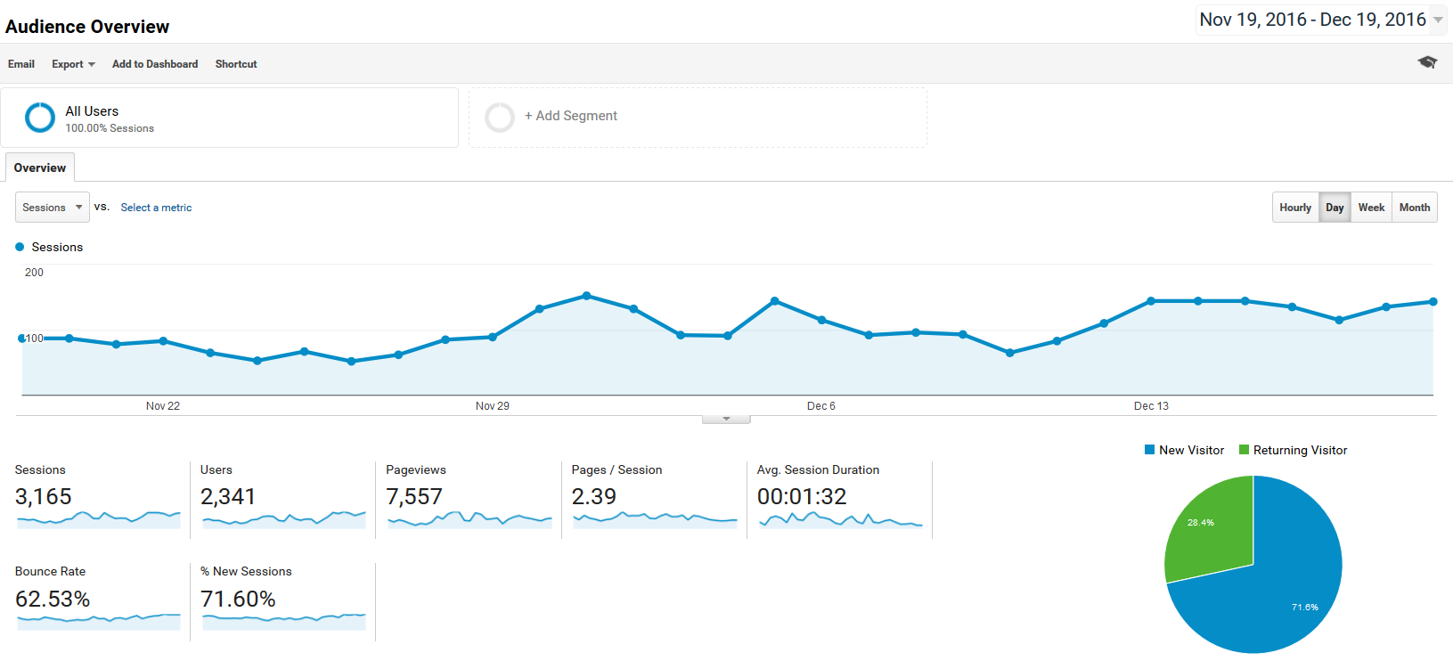
8. SEO and Design Optimization
AUDIENCE OVERVIEW
Google Analytics overview:
Sessions = Visits
How many visitors (new and returning) have been to your website

Slide 39
8. SEO and Design Optimization
AUDIENCE OVERVIEW
AUDIENCE OVERVIEW
Google Analytics overview:
Users = Unique Visitors
How many unique visitors (visitors that have not been to your website before)

Slide 40
8. SEO and Design Optimization
AUDIENCE OVERVIEW
AUDIENCE OVERVIEW
Google Analytics overview:
Pageviews
How many pages were visited/viewed within a specific timeframe

Slide 41
8. SEO and Design Optimization
AUDIENCE OVERVIEW
AUDIENCE OVERVIEW
Google Analytics overview:
Pageviews Per Visit
Average number of pages visited/viewed per visitor

Slide 42
8. SEO and Design Optimization
AUDIENCE OVERVIEW
Google Analytics overview:
Avg. Session Duration
Average amount of time a visitor stays on your website Note: In order to track, a visitor has to visit another page on your website

Slide 43
8. SEO and Design Optimization
AUDIENCE OVERVIEW
AUDIENCE OVERVIEW
Google Analytics overview:
Bounce Rate
Percentage of visitors that come to your website, visit one page, and then leave

Slide 44
8. SEO and Design Optimization
AUDIENCE OVERVIEW
AUDIENCE OVERVIEW
Google Analytics overview:
% New Sessions
Percentage of visitors that come to your website for the first time

Slide 45

International Markets
8. SEO and Design Optimization
AUDIENCE OVERVIEW
Through a process called localization, companies hire international Web developers to assist with translating Web site content into different languages for different cultures
www.landsend.com
http://www1.landsend.co.jp
http://www1.landsend.de

Slide 46

How does the cycle restarts?
New requirements, new developments, or major improvements

Slide 47
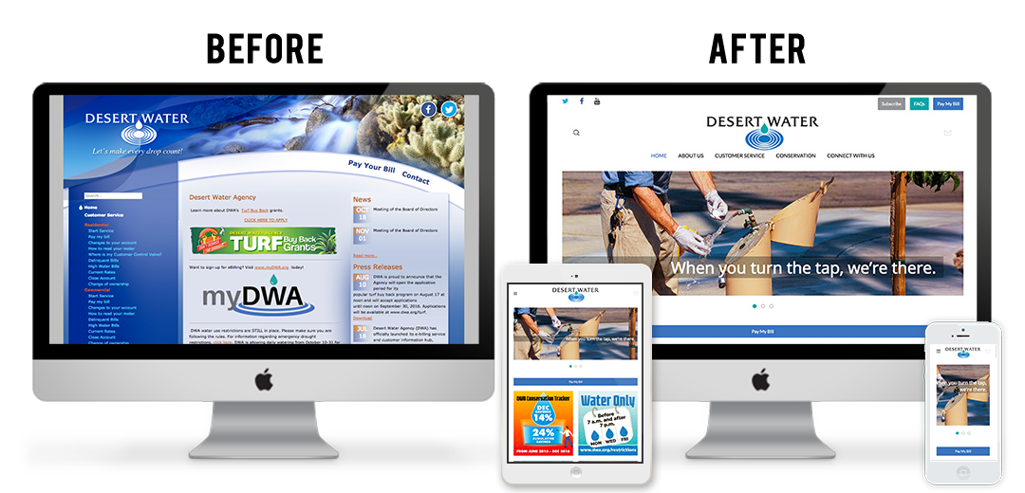
How does the cycle restarts?
AUDIENCE OVERVIEW
New requirements, new developments, or major improvements

Slide 48
End of part 4
Activity 10.4. True or false: Process of web design is a continuous process as website regularly require improvements.

